Slide 1
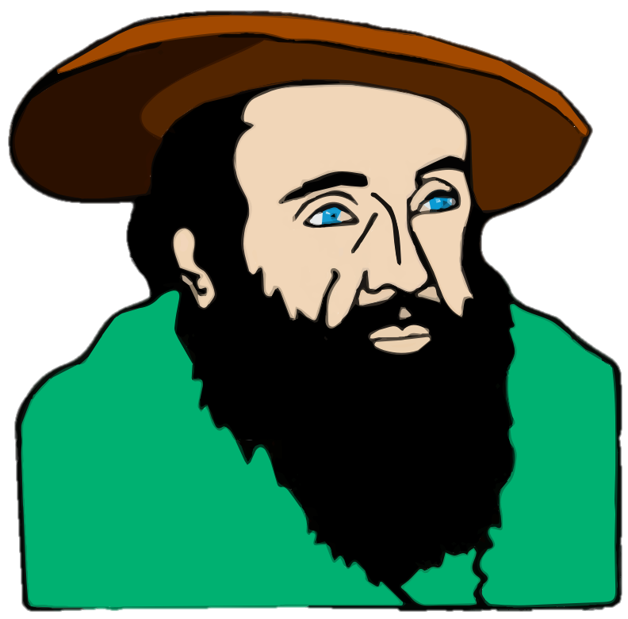
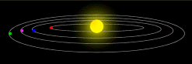
Early Astronomy,
Gravity, & Planetary Law

Slide 2
Essential Questions
What were the accomplishments of early astronomers?
How does the geocentric model differ from the heliocentric model of the solar system?
What are Kepler’s Laws of Planetary Motion?
What are astronomical units?
What is gravity?
What is the difference between mass and weight?
What is Newton’s Law of Universal Gravitation?

Slide 3
Astronomy Defined
Astronomy is the study of the universe
Properties of objects in space
Laws that predicts the way the universe operates

Slide 4

Aristotle (600 B.C. – 150 A.D.)
Aristotle was the first to conclude that the Earth is shaped like a sphere.
His evidence was that Earth casts a curved shadow on the moon when it passes between the sun and the moon.
The proof is in
the shadow!
THE EARTH IS ROUND!
The Earth is FLAT!

Slide 5
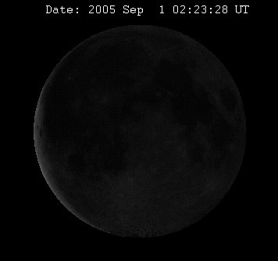
Oh, I See Now!
Told You So!

Slide 6
The Geocentric Model
Ancient Greeks believed in the geocentric model of the solar system.
In the geocentric model, the moon, sun, and known planets revolve around Earth in a perfect circular orbit.
Egyptian-Greek Astronomer Ptolemy published the first idea of the geocentric model called the Ptolemaic System in the 2nd century, and the model persisted as the accepted view for the next 1500 years.
Notes:
Image: GoPhysics

Slide 7
Aristarchus (312 B.C. – 230 B.C.)
Aristarchus was the first Greek to propose that the solar system is heliocentric.
In the heliocentric model, the Earth and other planets orbit the sun.
Although there was evidence
to support this model, the
geocentric model prevailed
for nearly 2000 years.

Slide 8
Claudius Ptolemy (100-160 A.D.)
Ptolemy though it was odd that planets appeared to move slightly eastward among the stars, then stop, and reverse motion, and then resume an eastward movement.
The apparent westward drift is called retrograde movement.
Results from combination of Earth and the planet’s own motion around the sun.
Ptolemy explained retrograde motion by saying the planets moved along smaller circles, which in turn moved along orbits around the Earth. He called these smaller circles epicycles.

Slide 9
The Universe & Aristotle
Click on the movie clapboard to watch video!
Notes:
https://www.youtube.com/watch?v=GevV1yvMJbc
4 The Universe Aristotle and Ptolemy
(3:57) Thomas Gigiano

Slide 10
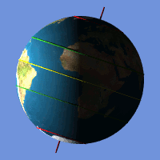
Nicolaus Copernicus (1473 – 1543)
Copernicus created the first detailed heliocentric model of the solar system.
Copernicus was the first to propose that:
Earth is a planet
Earth orbits the sun annually
Earth rotates daily on its own axis

Slide 11
Tycho Brahe (1546 – 1601)
Brahe built many instruments (before the invention of the telescope) that accurately studied and measured the locations of planets and stars
Brahe’s observations, especially of Mars, were more precise than another other scientists before him.
Tycho wore a prosthetic nose. He lost his nose in sword fight with his cousin. He kept it in place with paste.
Tycho Brahe hired Johannes Kepler as an assistant and Kepler kept most of Brahe’s work and put it to exceptional use.

Slide 12
Johannes Kepler (1571-1630)
Kepler Discovered the
3 Laws of Planetary Motion
In 1596, Kepler publicly wrote of support for Copernicus’s heliocentric model.
This was risky because the Lutheran and Catholic churches did not support this idea and even put Galileo under house arrest in 1615 for his publication of support of this sun-centered model.

Slide 13
Kepler’s 1st Law of Planetary Motion
The path around the sun is an ellipse.
The path of each planet around the sun is not perfectly circular, but instead an oval shape called an ellipse.
The ellipse contains two foci, or points.
The sun is at one focus
The other focus is symmetrically located at the opposite end of the ellipse
The distance between the 2 foci determines the shape of the ellipse. The farther apart the foci, the more elongated, or eccentric the ellipse is.

Slide 14
Kepler’s 1st Law of Planetary Motion
Ellipses have eccentricity.
Eccentricity is the measurement of how elongated a closed circle is and is measured from the foci to the length of the major (longer) axis.
Eccentricity is measured in values of 0 to 1
A perfect circle has only a single focus and an eccentricity of zero.
Ellipses can have a value of 0.1 to 1. The greater the value, the more elongated the ellipse is.
Which shape is most eccentric? Which shape has an eccentricity of zero?

Slide 15
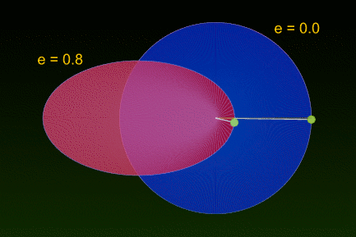
Kepler’s 1st Law of Planetary Motion
The value of eccentricity is easy to find using the formula E = d / L
E = eccentricity
d = distance between 2 foci
L = length of the major axis
To find the eccentricity, follow these steps:
Measure the distance between the foci
Measure the distance of the long major axis
Divide the distance between the two foci (d) by the length of the major axis (L)
Line A-B represents the major axis. F1 and F2 represent the foci. Label these points on your paper

Slide 16
Kepler’s First Law of Motion
Click on the movie clapboard to watch video!
Notes:
https://www.youtube.com/watch?v=qDHnWptz5Jo
Kepler’s First Law of Motion - Elliptical Orbits (Astronomy)
Socratica 3:18

Slide 17
Kepler’s 2nd Law of Planetary Motion
Kepler noticed that the speed of Mars in its orbit changes in predictable ways.
As Mars approaches perihelion, it speeds up.
As it approaches aphelion, it slows down.
Perihelion: the point in a planet’s orbit closest to the sun
On Earth: 147 million km
Occurs annually on Jan 3
Aphelion: the point in a planet’s orbit farthest away from the sun
On Earth: 152 million km
Occurs annually on July 4
Label the Perihelion and Aphelion on your paper.

Slide 18
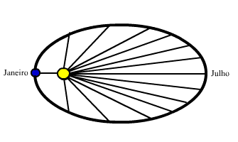
Kepler’s 2nd Law of Planetary Motion
Each planet revolves so that an imaginary line connecting it to the sun sweeps over equal areas in equal time intervals.
If a planet is to sweep equal areas in the same amount of time, it must move more faster at perihelion and slower at aphelion.
The sun’s gravity pulls stronger on the planet when it is closest to it, causing it to move faster.
As distance increase between two objects, the force of gravity decreases, causing a planet to move slower at aphelion.
Perihelion
Aphelion

Slide 19
Kepler’s 2nd Law of Motion
Click on the movie clapboard to watch video!
Notes:
Kepler’s Second Law of Motion (Astronomy)
Socratica 3:35
https://www.youtube.com/watch?v=qd3dIGJqRDU

Slide 20
Kepler’s 3rd Law of Planetary Motion
The closer a planet is to the sun, the shorter the orbital period is.
An orbital period is the time it takes for a planet to complete one orbit around the sun in Earth years.
1 orbital period = 1 Earth year
The orbital period squared is equal to its mean solar distance cubed or T² = d³
T stands for orbital period in Earth years
d stands for distance from the sun in astronomical units

Slide 21
Astronomical Units
The distance from the Earth to the Sun is
93 million miles or 1 Astronomical Unit
Astronomical Units are used to measure distances in our solar system.
1 Astronomical Unit (AU) =
93 million miles or 150 million kilometers

Slide 22
Kepler’s 3rd Law of Planetary Motion
If the closer a planet is to the sun, the shorter the orbital period, then which planet has the…
-Shortest orbital period?
Mercury
-Longest orbital period?
Neptune
-Orbital periods closest to Earth’s orbital period?
Venus and Mars

Slide 23
Orbital Periods and Solar Distances of Planets
Planet | Solar Distance (d) (AU) | Orbital Period (T) (Earth Years)
Mercury | 0.39 | 0.24
Venus | 0.72 | 0.62
Earth | 1.00 | 1.00
Mars | 1.52 | 1.88
Jupiter | 5.20 | 11.86
Saturn | 9.54 | 29.46
Uranus | 19.18 | 84.01
Neptune | 30.06 | 164.80

Slide 24
Kepler’s 3rd Law of Motion
Click on the movie clapboard to watch video!
Notes:
https://www.youtube.com/watch?v=KbXVpdlmYZo&t=284s
Kepler’s Third Law of Motion (Astronomy)
Socratica 5:54

Slide 25
Galileo Galilei (1564 – 1642)
Galileo was a groundbreaking astronomer whose inventions included a telescope, thermometer, and compass.
Using his telescope, he was able to view the universe in a new way and made many discoveries that supported the ideas of Copernicus and Kepler.
Galileo spent the last few years of his life under house arrest for his support of the heliocentric model of the solar system.

Slide 26
Thermometer
Compass
Telescope

Slide 27
Galileo Galilei
Click on the movie clapboard to watch video!
Notes:
https://www.youtube.com/watch?v=NMM8vx9vDiE
Galileo Galilei - in a nutshell
Nutshellia 2:45

Slide 28
Galileo’s Discoveries
Galileo’s discoveries include:
Four satellites, or moons, orbit Jupiter.
Planets in the distance are circular disks, not stars.
Earth’s moon’s surface is not smooth, it contained mountains, craters, and plains.
The sun had spots, or dark regions and the sun had a rotational period of just under one month.

Slide 29
Mass Versus Weight
Mass:
The total amount of matter (think atoms) in an object.
Mass is constant and does not change with location
Measured in kilograms (kg)
Weight:
The force of gravity acting
on an object.
Weight changes depending
where you are in the universe
Measured in Newtons (N)
Notes:
Optional Video: https://www.youtube.com/watch?v=Y8-T8RouhPA
Is mass the same as weight? (1:48)
Moo Moo Math and Science

Slide 30
Click On This Bar For Interactive
Notes:
Interactive: Your Weight on Other Planets: http://www.seasky.org/solar-system/planet-weight-calculator.html

Slide 31
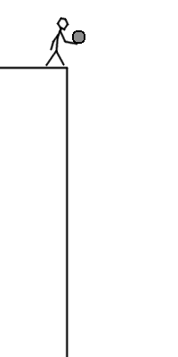
Gravity
Gravity is from the Latin word gravitas, meaning weight
Gravity is a force by which all things with mass or energy, including planets, stars, and galaxies are brought toward one another.
Gravity gives weight to objects
Earth’s gravitational acceleration is 9.8 m/s²
The gravitational attraction of the matter present in the universe cause it to coalesce into stars, galaxies, and even planets.

Slide 32

Gravity
Without gravity, planets would not move in an elliptical orbit. Instead, planets would move in a straight line out into space.
The greater the mass of an object, the greater its gravitational force.
The closer two objects are together, the greater the gravitational force.
The object with the greater mass will have more gravitational force.
Why do you think you fall down to Earth and not up towards the Sun?
Notes:
Optional Gravity Video
https://www.youtube.com/watch?v=lY3XV_GGV0M
How to Think About Gravity (4:43)
TedEd

Slide 33
Isaac Newton (1642-1727)
Newton was the first person to formulate and test the Law of Universal Gravitation.
The Law of Universal Gravitation states:
Every object in the universe attracts every other object with a force that is directly proportional to their masses and inversely proportional to the square of the distance between their centers of mass.
Newton believed gravity and inertia are two factors that keep the planets in orbit.

Slide 34
Law of Universal Gravitation
F= gravitational force between 2 objects
m₁ & m₂ = masses of the objects
r = distance between the centers of the masses of the objects squared
G = gravitational constant 6.67 x 10⁻¹¹

Slide 35
Gravity
Click on the movie clapboard to watch video!
Notes:
SciShow (3:36)
Gravitation: The Four Fundamental Forces of Physics #3
https://www.youtube.com/watch?v=yhG_ArxmwRM

Slide 36
Essential Question Check
Answer these questions in your notes.
List the accomplishments of Aristotle, Aristarchus, Copernicus, Ptolemy, and Brahe.
What is the difference between a heliocentric and geocentric model of the solar system?
List Kepler’s 3 Laws of Planetary Motion.
How is the eccentricity of an ellipse measured?
What is an astronomical unit?
What invention did Galileo make that helped him discover new things about our solar system?
What is the difference between mass and weight?
Why does the moon orbit the Earth and not the sun?
What did Newton discover?
Describe how gravity works between two objects.

Slide 37

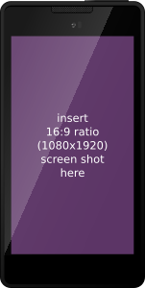

Let’s See What You’ve Learned!
Students – Go to Kahoot.it
Get Your Electronic Devices Ready for FUN!
Teachers need a free account to facilitate! It’s Easy and Effective!
Students do not need accounts! Students LOVE Kahoot!!!
Notes:
Kahoot Link:
https://play.kahoot.it/#/k/3ae2996d-6751-4852-b8b5-91bb1075fb68

Slide 38
Science Is Real! Terms of Use (TOU):
- Copyright © Ana Ulrich Catts. All rights reserved by author. Purchase of the product is for single classroom use by the purchaser only. It is a violation for individuals, schools, and districts to redistribute, edit, sell, or post this item on the Internet or to other individuals. Copying for more than one teacher, classroom, department, school, or school system is prohibited. This product may not be distributed or displayed digitally for public view. Disregarding the copyright is a violation of the Digital Millennium Copyright Act and subject to legal action.
-By purchasing this product you acknowledge that you have read and understood the Terms of Use.
HAPPY SCIENCING!

Slide 39

CLICK TO FOLLOW ME!

